Slide 1
US Fruit & Veggie Export Prediction with LSTM model
Date: Nov 19, 2019
John Kim

Slide 2
Agenda
Project Overview
Model Selection Approach
Model Chosen
Process
Result
Demo
Lesson Learned

Slide 3
Project Overview
Based on the US produce monthly export history data, we tried to use a few models to predict the coming month export $ amount

Slide 4
Model Selection Approach
First we tried Linear Regression with the yearly data, but found no linear relationship
Then we tried Linear Regression with the monthly data, but found no linear relationship either.
So we tried to find a different model which is more appropriate to the time series or sequence data. We found LSTM model working much better with our data. Thus we decided to go with this LSTM model

Slide 5
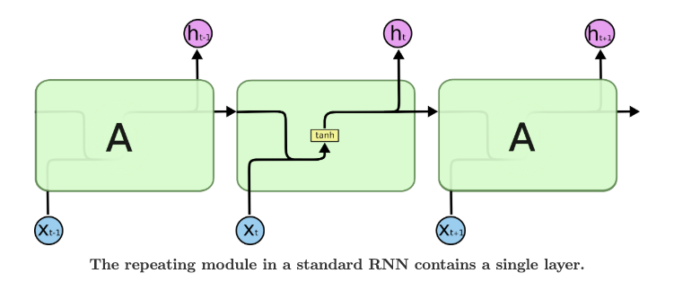
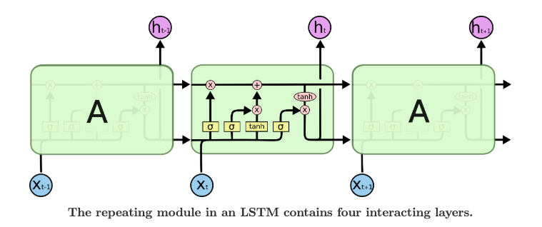
Model Chosen
LSTM In Brief
RNN has a problem of learning
long-term dependencies.
- With long sequence, gradient could be vanished
- Back-propagation could not be done properly
- Vanilla RNN is weak to learn long sequence
LSTM solves the vanishing gradient
problem by having horizontal cell
state line running through all the layers
Cell state: flow of precious information thru time
Gate: control pass or block of the information of each dimension
with coefficient 0 ~ 1

Slide 6
Project Process
Build Model Train Model/
Predict
MSE
Accept-able?
Data Cleaning & Prep
Model
Choose
Data Split
Linear Regression,
LSTM
Scaler
Train Data
Test Data
Model.summary
Model.fit
Tune Model
Train Model/
Predict
Flask,
App.py
HTML/
CSS/JS
Heroku
Try different:
Epochs
Optimizer
Bbatch size
Model.summary
Model.fit

Slide 7
Result/Live Demo
Live Demo !

Slide 8
Lesson Learned

Slide 9
Lessons Learned
LSTM is working great overall !
The more data, the better
Watch out for overfitting, which happens when a neural network essentially “memorizes” the training data. Overfitting means you get great performance on training data, but the network’s model is useless for out-of-sample prediction
Log your project endeavors (debugging log, learning query log …)

Slide 10
Next Step
Keep learning !
Try another LSTM project with more data & different areas.
Explore other projects with famous ML models (CNN/GAN) to deepen the knowledge
Revisit the codes later to see if I can use more efficient and cleaner codes than the current ones after I learn myself more

